Slide 1






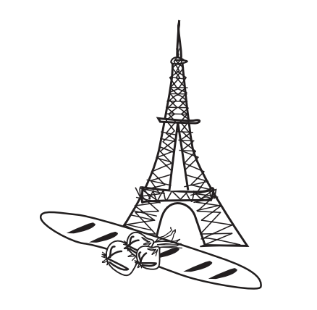

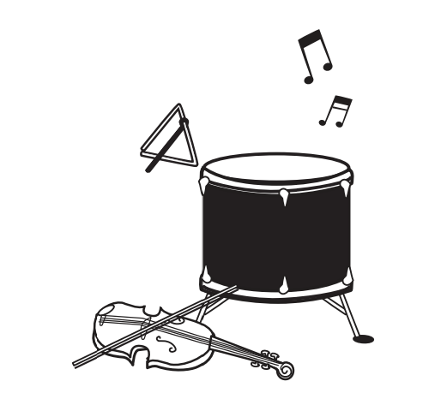
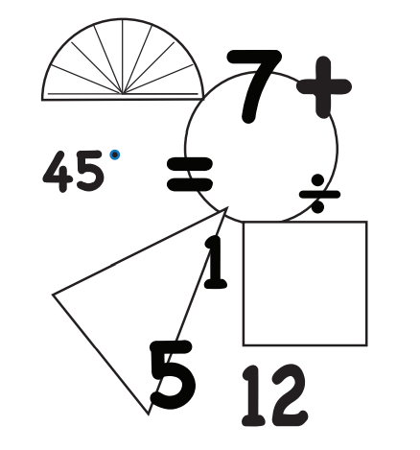
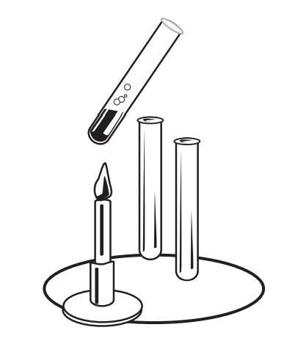




Les matières
School subjects
French Knowledge Organiser – Year Six – Autumn 1
À L’École (at school)
Est-ce que tu aimes…? (Do you like…?)
Oui, j’aime... | Yes, I like…
Oui, j’adore... | Yes, I love…
Non, je n’aime pas... | No, I do not like…
Non, je déteste... | No, I hate…
J’étudie…
I study…
Quelle est ta matière préférée?
What is your favourite subject?
Ma matière préférée c’est…
My favourite subject is…
L’informatique | L’histoire | L’anglais | Le dessin | Le français | Le sport | La géographie | La musique | Les maths | Les sciences
ICT | history | English | art | French | P.E. | Geography | Music | Maths | science
..parce que… | …car…
…because … | …because …
…c’est…
…it is …
amusant | utile | intéressant | facile | ennuyeux | difficult | inutile
fun | useful | interesting | easy | boring | difficult | pointless
le lundi | on Mondays
la dimanche | on Sundays
 | (see Year 1 knowledge organiser for the days of the week)
Quelle heure est-il? (What time is it?)
Grammar
In French, when one word ends with a vowel and the next one starts with a vowel, the first word loses the vowel and is replaced with an apostrophe Je + étudie → J’étudie
After ‘c’est’ (it is) the adjectives will remain in masculine, singular form. Liaison: the ‘t’ in ‘c’est’ is only pronounced when the next word is a vowel. | All the days of the week are masculine (use ‘le’) except from Sunday (use ‘la’).
à onze heure. | at eleven o’clock.
à douze heure. | at twelve o’clock.
minuit | midnight
midi | midday
 | (see Year 1 knowledge organiser for numbers 1-10)

