Slide 1




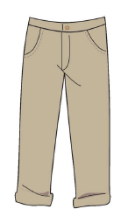
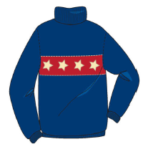
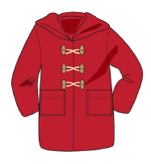
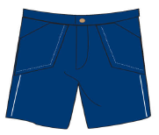
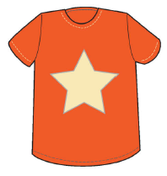
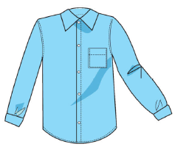
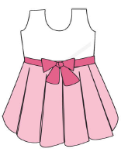
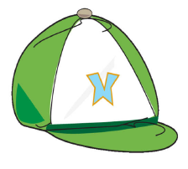
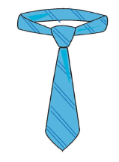
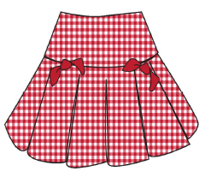
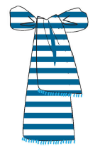
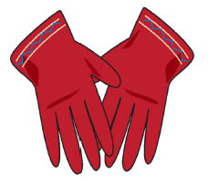
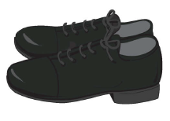
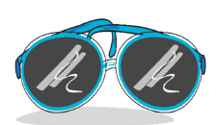
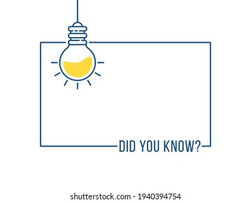

French Knowledge Organiser – Year Four – Spring 1
les vêtements (clothes)
un pantalon (a pair of trousers) | un pull (a jumper) | un manteaux (a coat) | un short (a pair of shorts) | un tee shirt (a t-shirt)
une chemise (a shirt) | une robe (a dress) | une casquette (a cap) | une cravat (a tie) | une jupe (a skirt)
une écharpe (a scarf) | des gants (a pair of gloves) | des chaussures (a pair of shoes) | des lunettes (a pair of glasses)
At school…
À l’école…
When it is cold…
Quand il neige…
…I wear…
…je porte…
When the weather is good…
Quand il fait beau…
When I am on holiday…
Quand je suis en vacances…
Grammar
The word ‘trouser’ in French is singular Some is used for ‘a pair of’ = ‘des’
When describing the colour of clothing, if the clothing is feminine, add an ‘e’ to the end of the colour (if it doesn’t already end in an ‘e’)
You say the
colour after
the clothing
in French, e.g. Je porte
un tee shirt orange.
We will be introduced to 21 different items of clothing, but these are some main items to learn.

