Slide 1


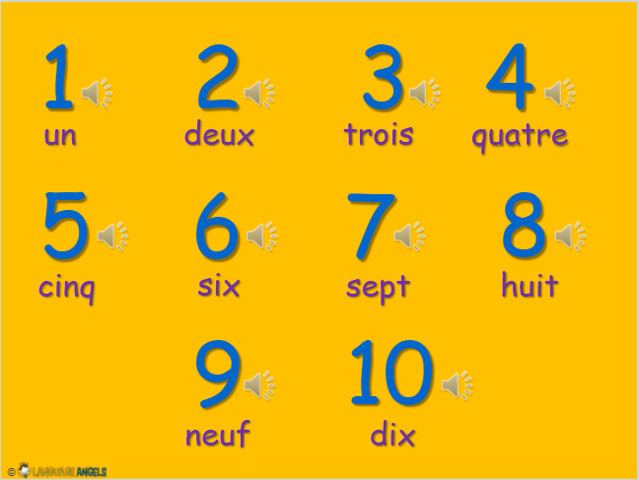



French Knowledge Organiser – Year One – Spring 2
les nombres (numbers)

