Slide 1



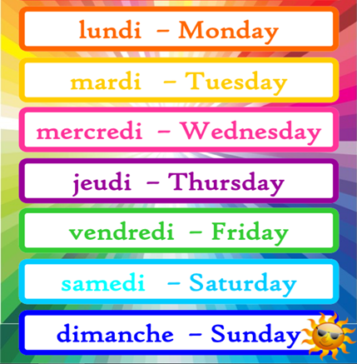
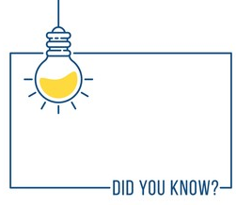


French Knowledge Organiser – Year One – Summer 2
les jours de la semaine (the days of the week)
Days of the week are not capitalised in French!

