Slide 1




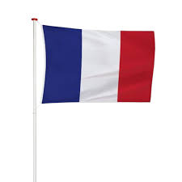







French Knowledge Organiser – Year One – Autumn 2
les colours (colours)

