Slide 1



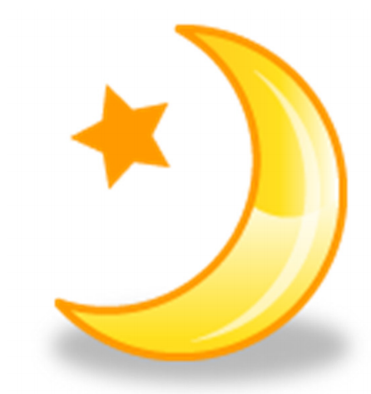

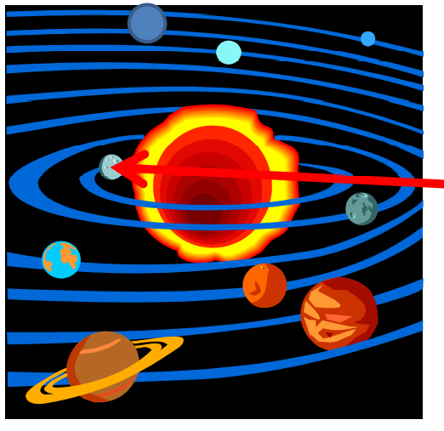

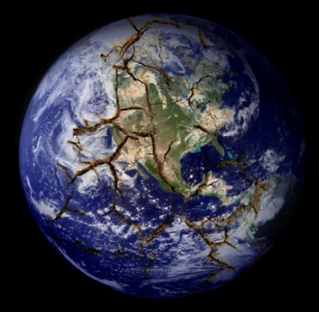
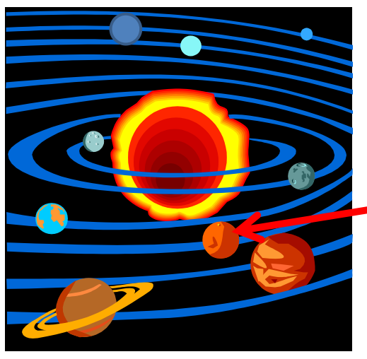

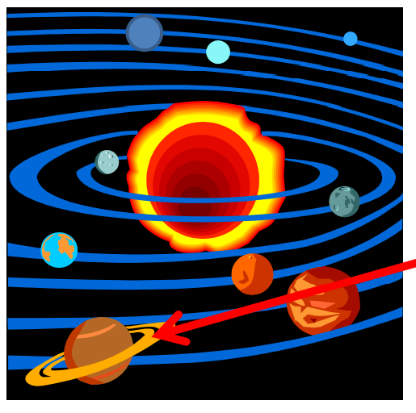
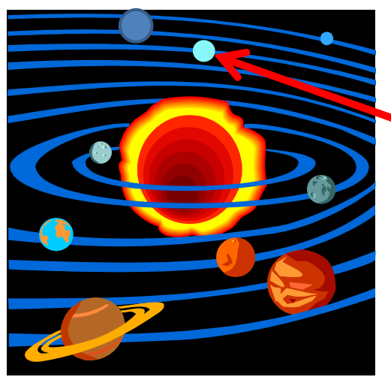
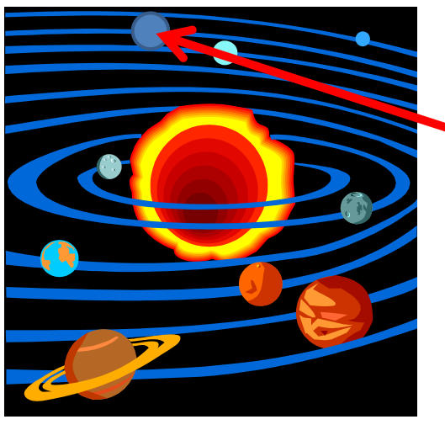
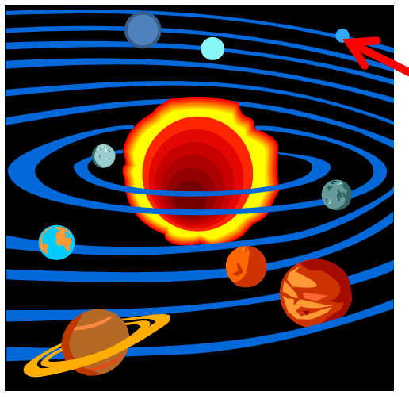


French Knowledge Organiser – Year Five – Summer 2
les planèts (the planets)
La lune | Le soleil | Mercure | Vénus | La Terre | Mars | Jupiter | Saturne | Uranus | Neptune | Pluton
Grammar
Adjectival agreement: You say the colour after the noun in French, e.g. Je porte un tee shirt orange.
The adjective must also agree with the gender of the noun!
Neptune | est | une | planète bleue.
Neptune | is | a | blue planet.
 | Masculine singular | Feminine singular | Masculine plural | Feminine plural
 | bleu | bleue | bleus | bleues
 | noir | noire | noirs | noires
 | vert | verte | verts | vertes
 | gris | grise | gris | grises
 | rouge |  | rouges
 | jaune | jaune | jaunes
 | marron | marron
 | crème
 | orange
Jupiter | est | ènorme.
Jupiter | is | enormous.
Le | soleil | est au | centre.
The | sun | is in the | centre.
Mercure | est | assez | petite | et | près | du | soleil.
Mercury | is | quite | small | and | near | to the | sun.

